Slide 1
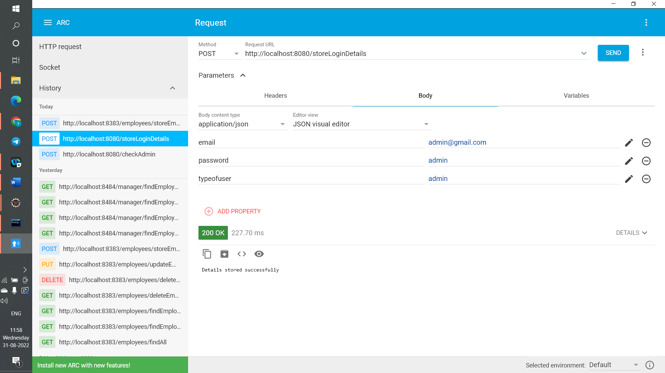
http://localhost:8080/storeLoginDetails this URL is used to store LoginDetails

Slide 2
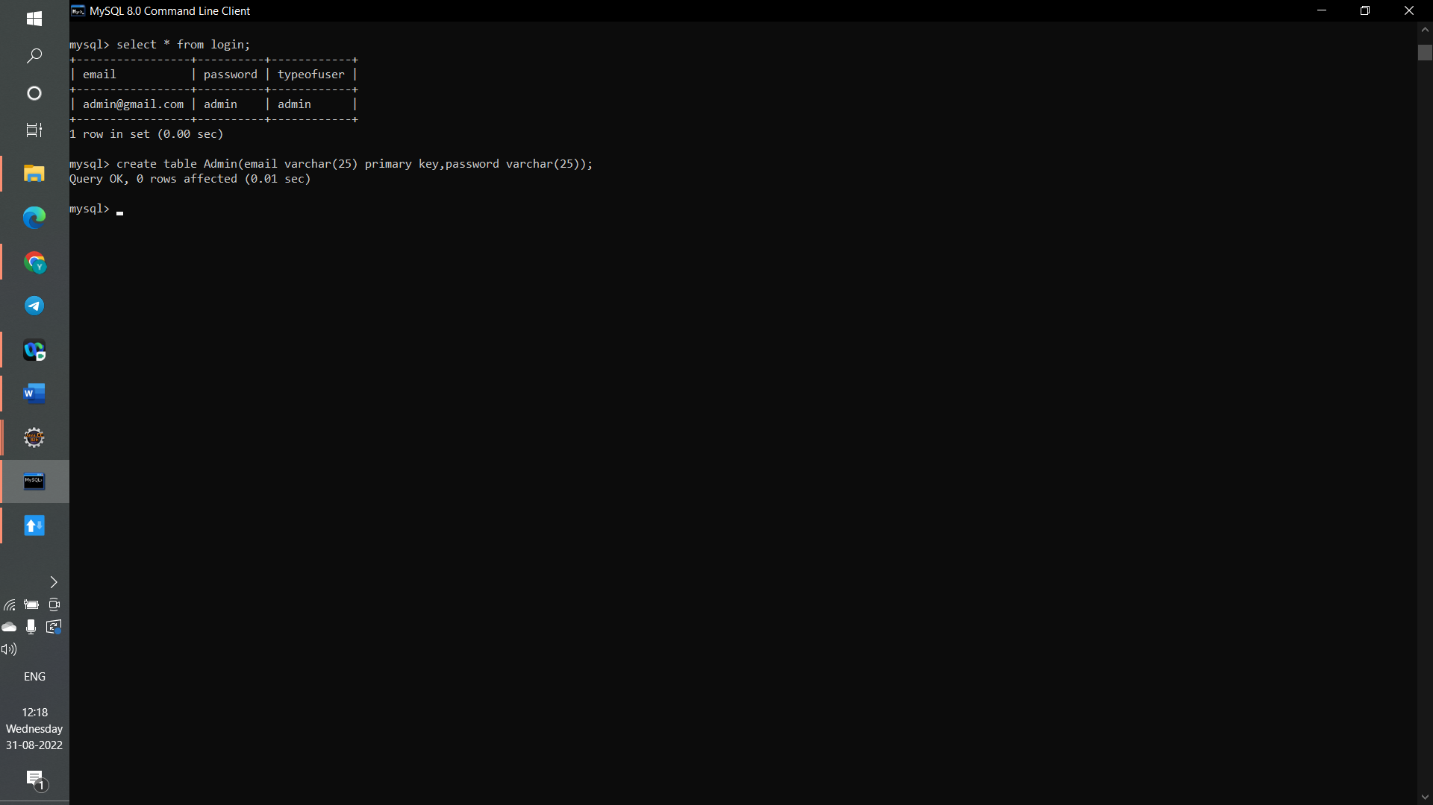

Slide 3
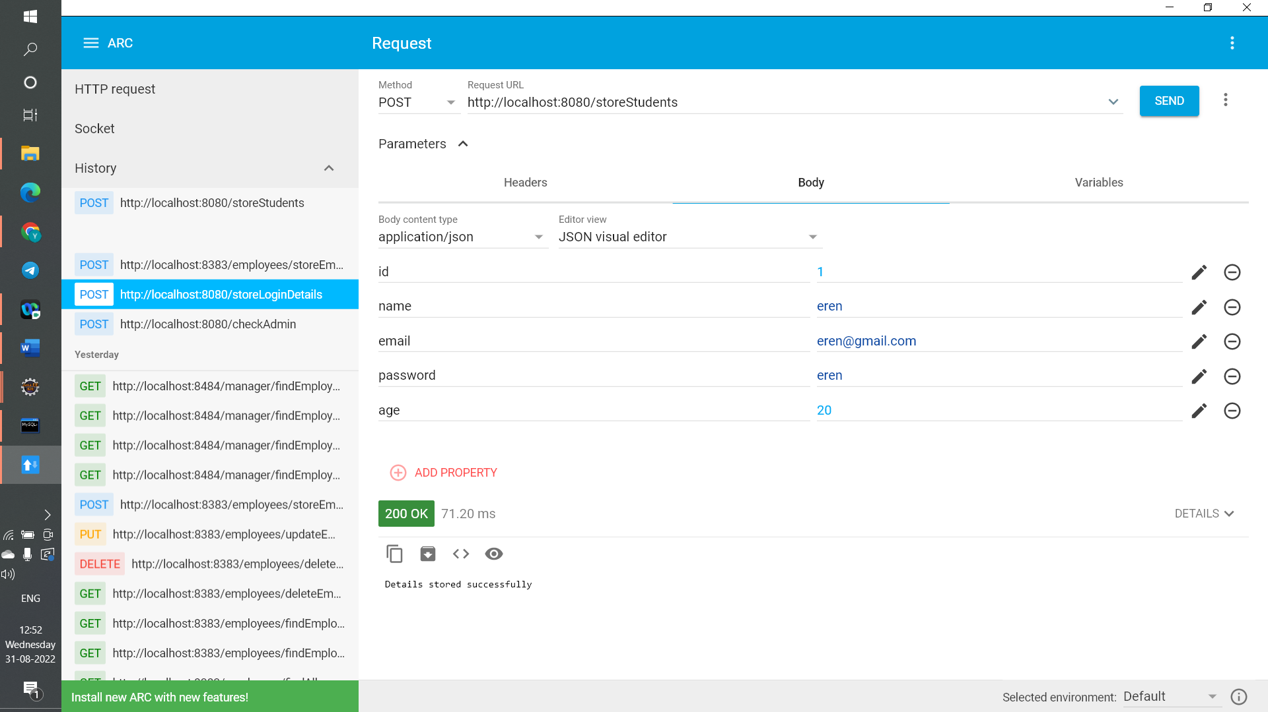
http://localhost:8080/storeStudents this URL is used to store students

Slide 4
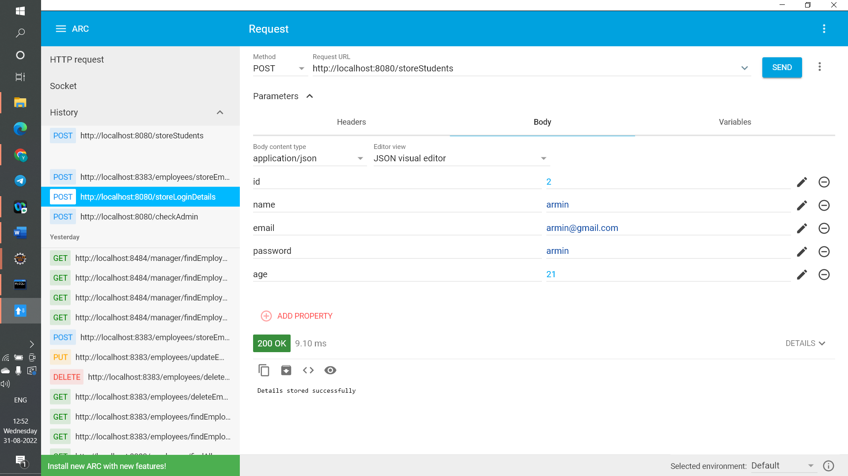

Slide 5


Slide 6
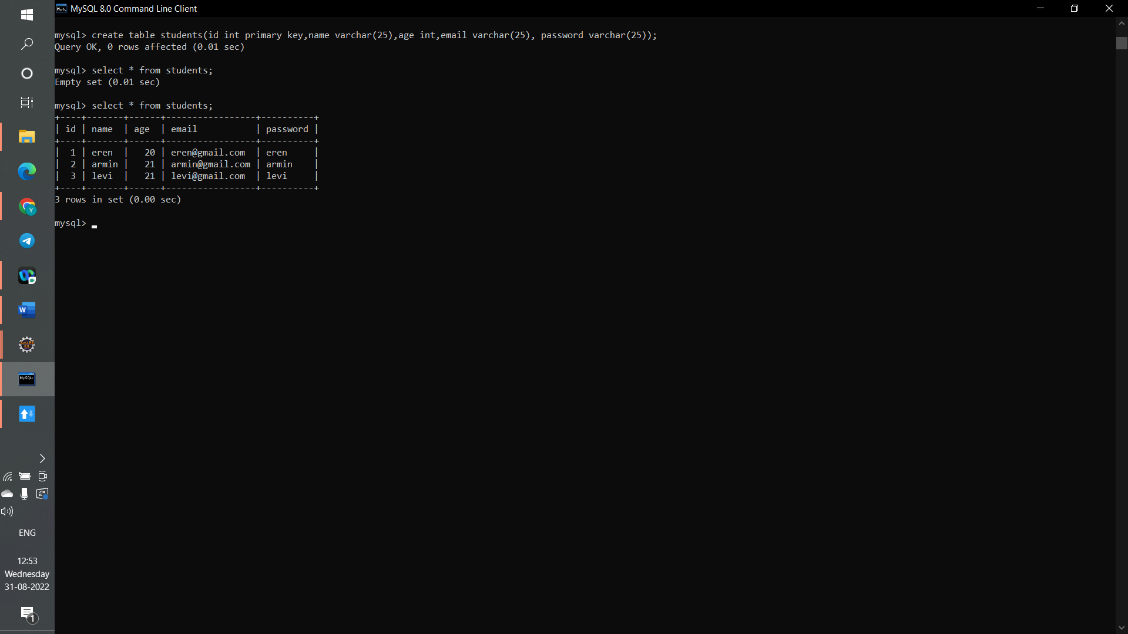

Slide 7
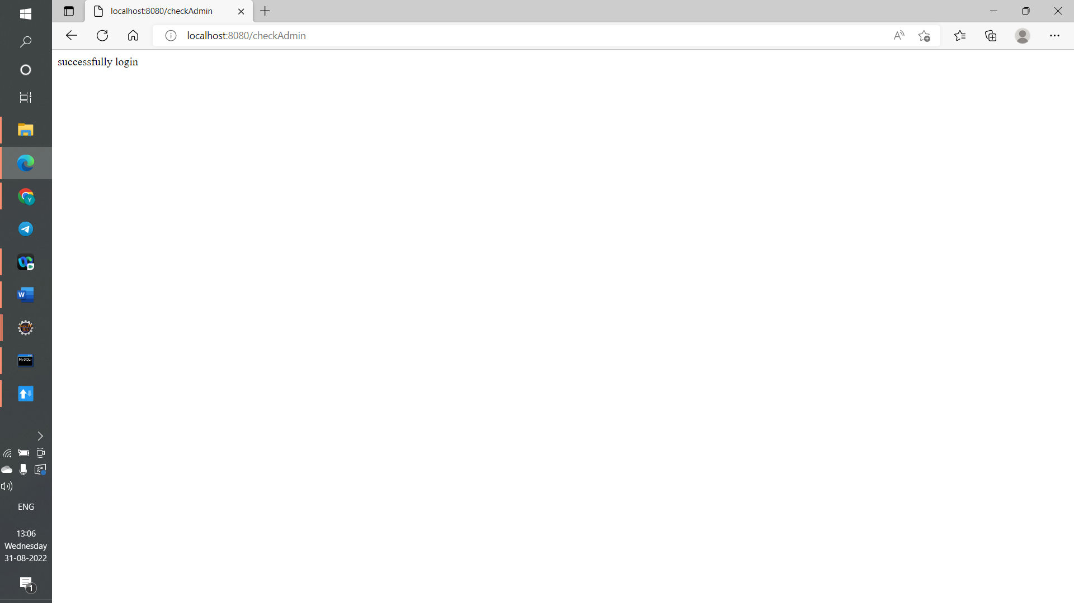

Slide 8
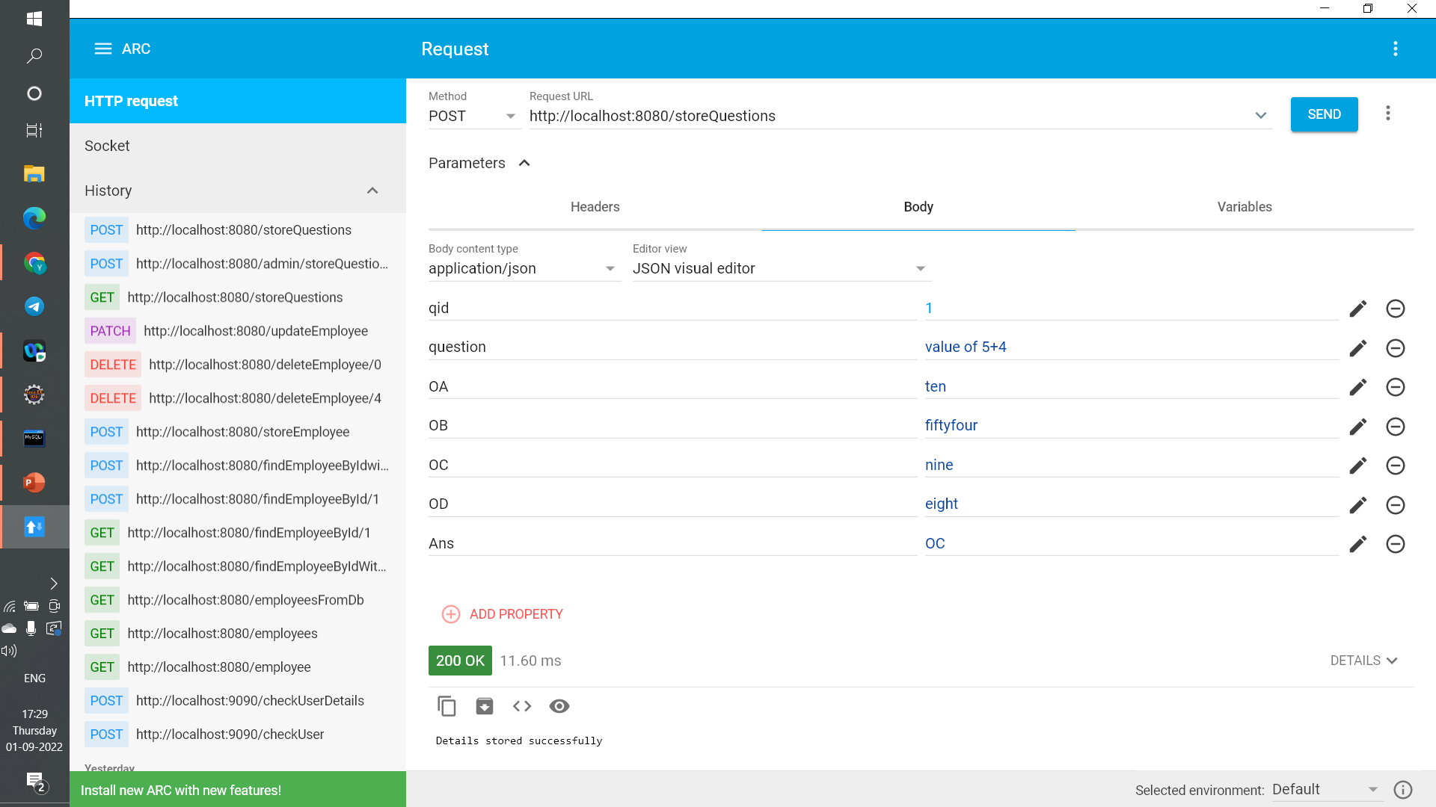
http://localhost:8080/storeQuestions this URL is used to store questions by admin

Slide 9


Slide 10
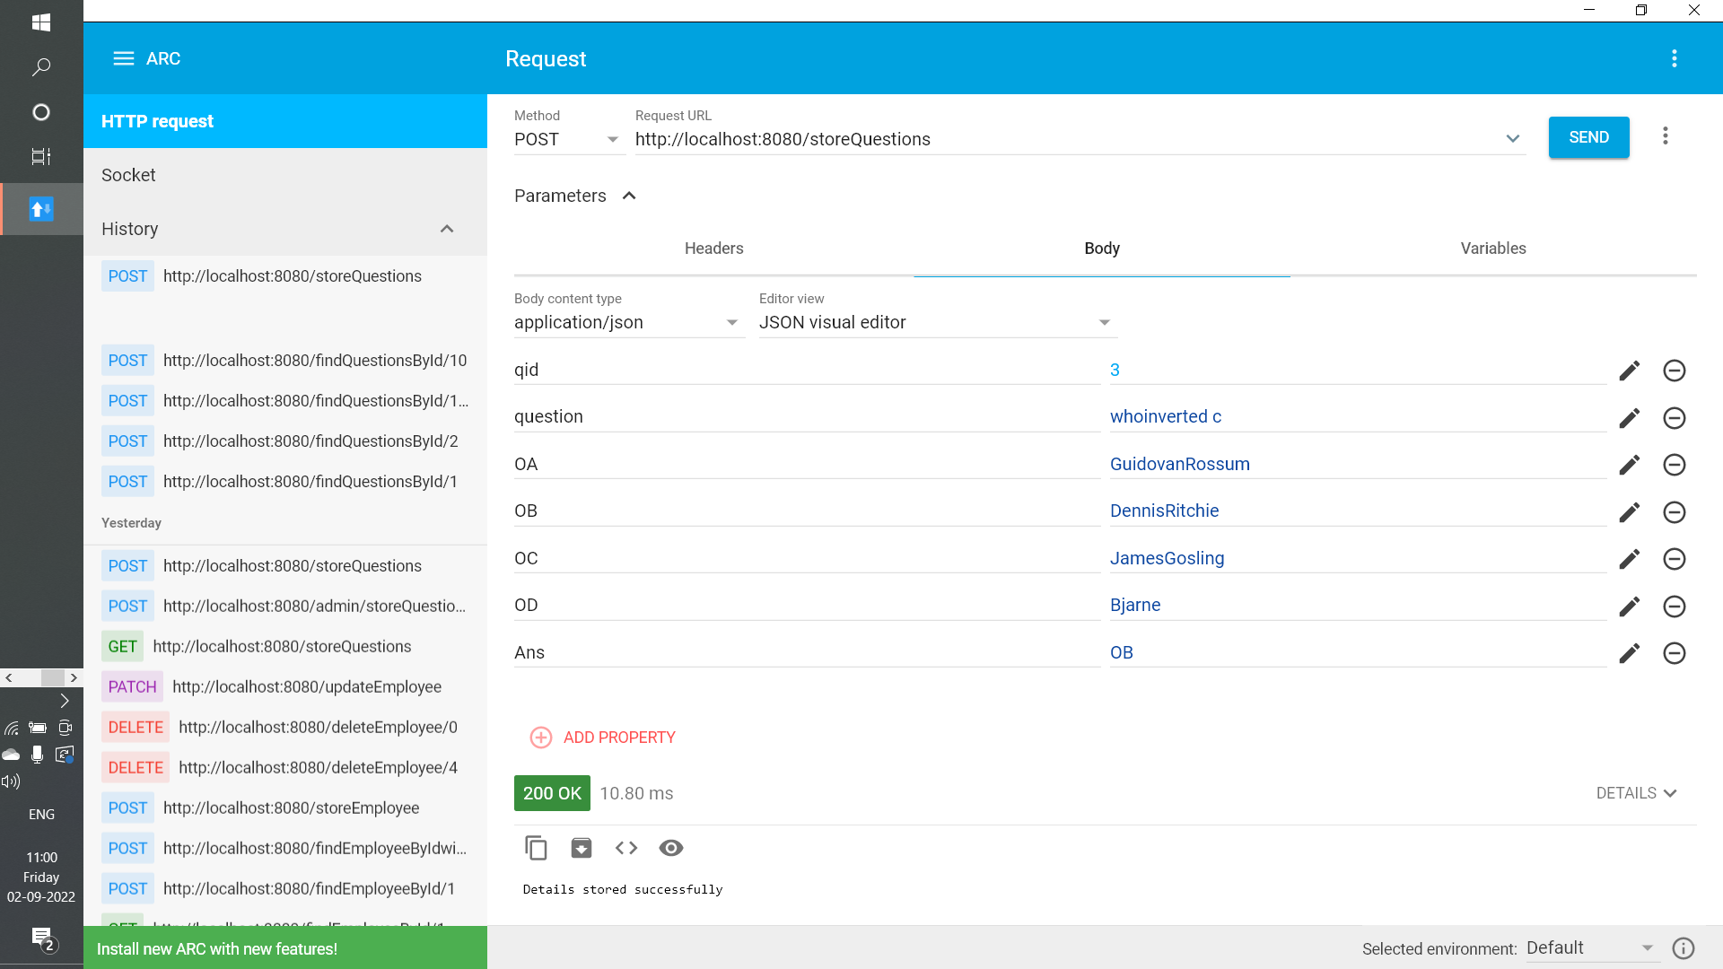

Slide 11
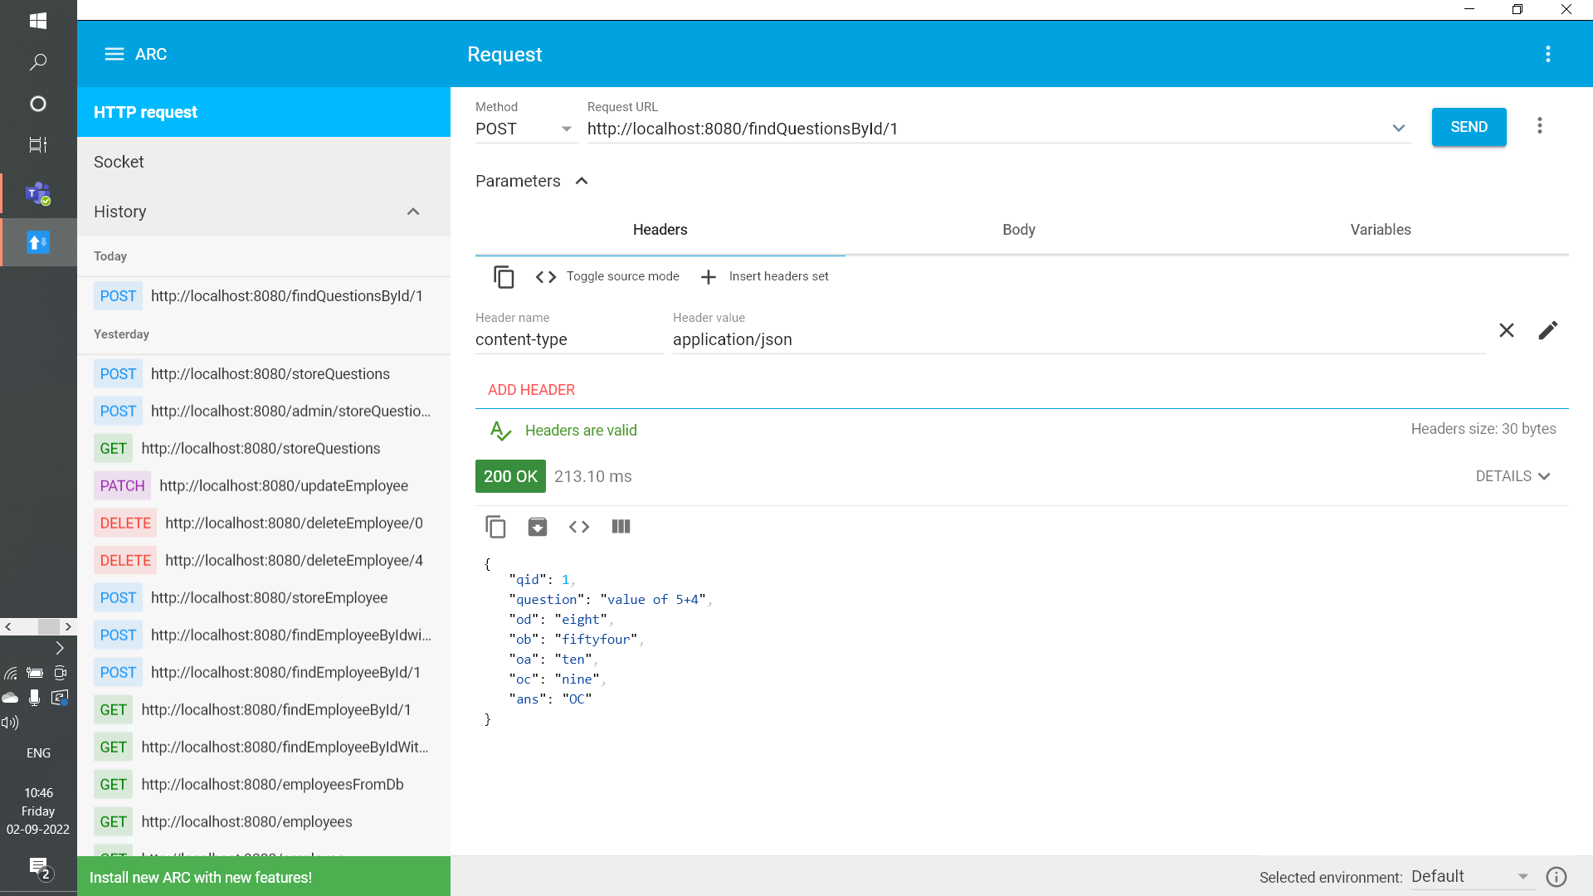
http://localhost:8080/findQuestionsById/1 this URL is used to find question using id by admin

Slide 12


Slide 13
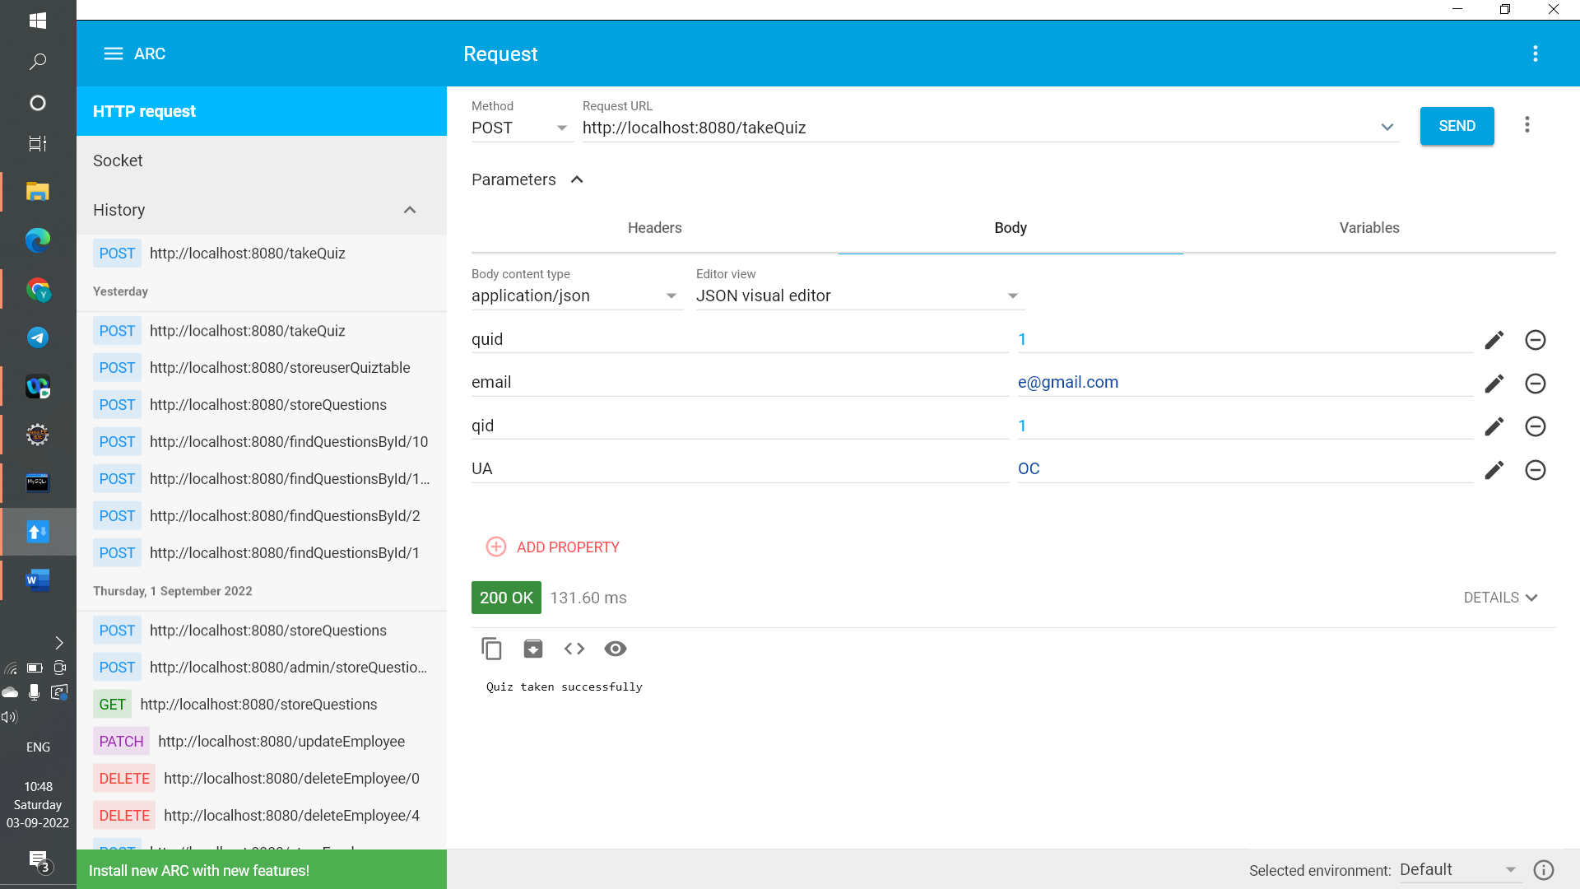

Slide 14
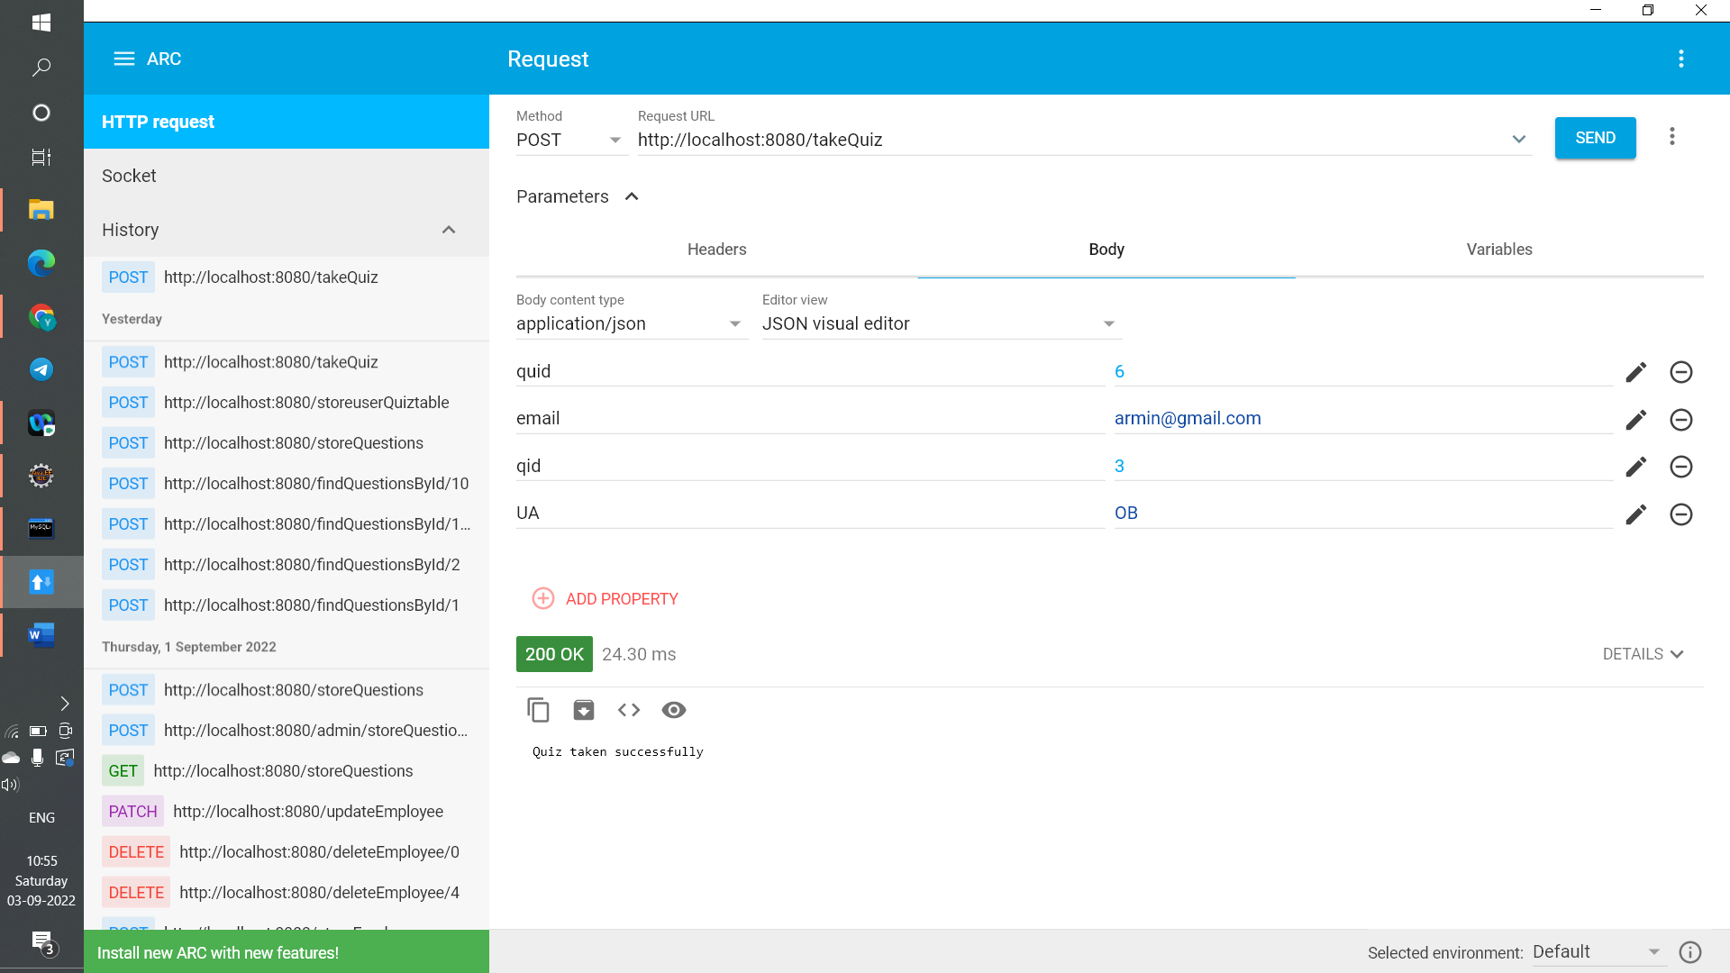

Slide 15


Slide 16
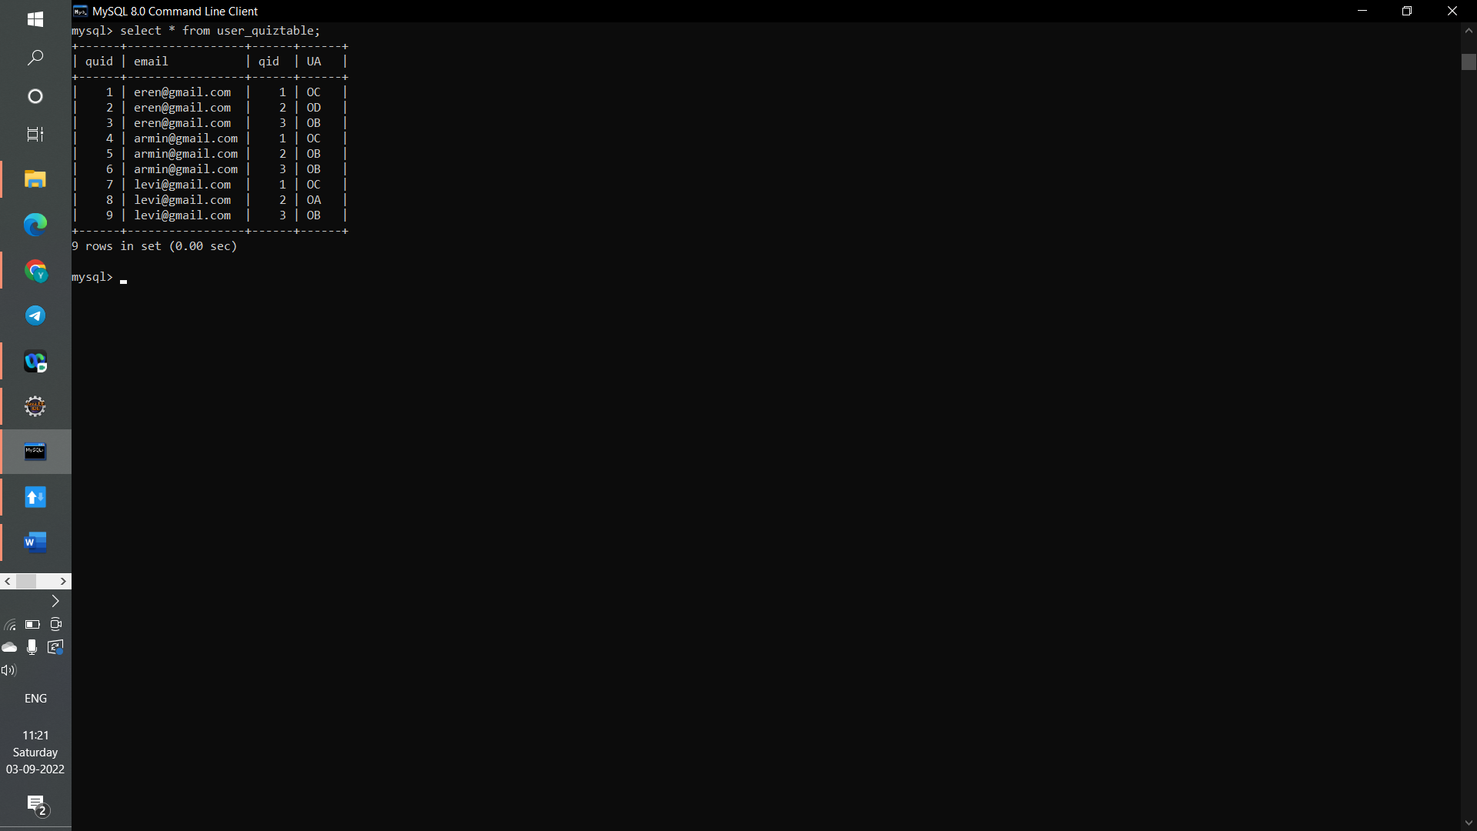

Slide 17
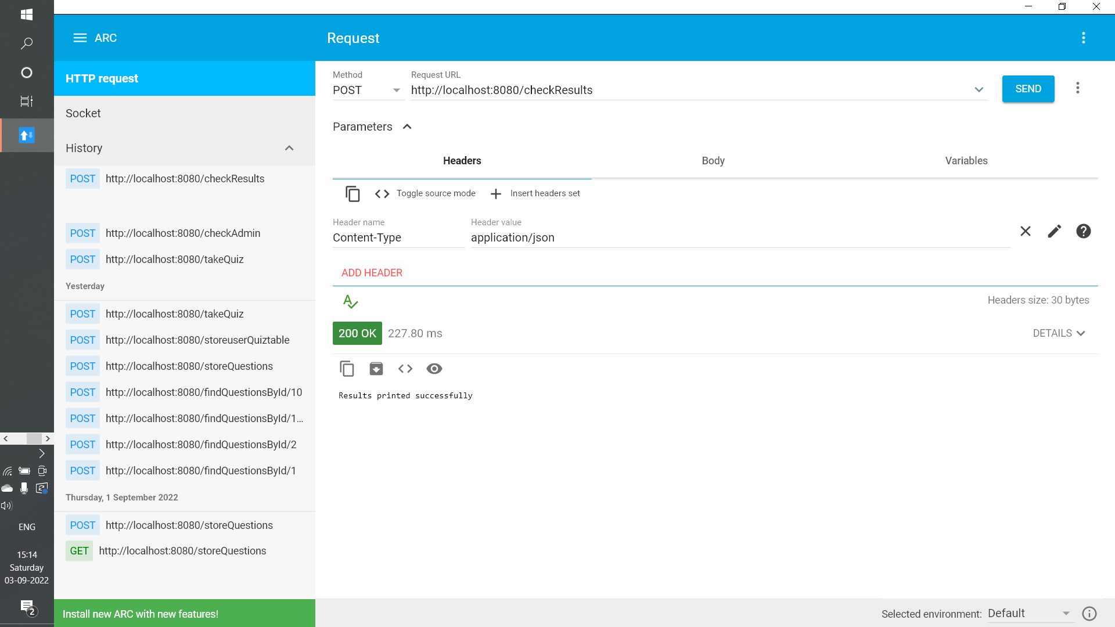

Slide 18
